Slide 1
Project Scheduling
.

Slide 2
Introduction
Involves deciding which tasks would be taken up when
Project Manager need to do the following
Identify all the tasks
Break down large tasks into small activities
Determine the dependency among activities
Estimate the time duration to complete the activities
Allocate resources to activities
Plan start and end dates
Determine the Critical path
Task dependencies
Milestones

Slide 3
“Failing to plan is planning to fail” by J. Hinze, Construction Planning and Scheduling
Planning:
“what” is going to be done, “how”, “where”, by “whom”, and “when”
for effective monitoring and control of complex projects

Slide 4
“Its about time” by J. Hinze, Construction Planning and Scheduling
Scheduling:
“what” will be done, and “who” will be working
relative timing of tasks & time frames
a concise description of the plan

Slide 5
“Once you plan your work, you must work your plan” by J. Hinze, Construction Planning and Scheduling
Planning and Scheduling occurs:
AFTER you have decided how to do the work
“The first idea is not always the best idea.”
Requires discipline to “work the plan”
The act of development useful,
But need to monitor and track
only then, is a schedule an effective management tool
as-built schedules

Slide 6
Activity Network
Activity network shows
Different activities
Estimated durations
Interdependencies

Slide 7
Network Diagrams
Network diagrams are the preferred technique for showing activity sequencing.
A network diagram is a schematic display of the logical relationships among, or sequencing of, project activities.
Two main formats are the arrow and precedence diagramming methods.

Slide 8
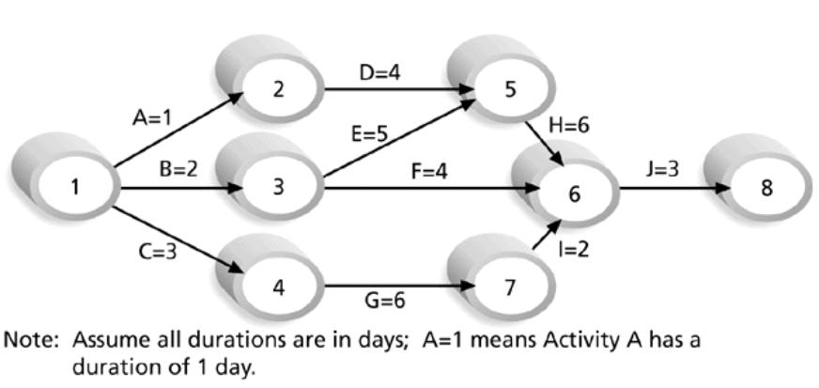
Activity Network Diagram for Project X

Slide 9
Techniques of Scheduling
CPM
PERT
GANTT

Slide 10
The PERT/CPM Approach for Project Scheduling
The PERT/CPM approach to project scheduling uses network presentation of the project to
Reflect activity precedence relations
Activity completion time
PERT/CPM is used for scheduling activities such that the project’s completion time is minimized.

Slide 11
Critical Path Method
It is the chain of activities that determines the duration of the project.
Different Parameters:
Earliest Start (ES) Time
Latest Start (LS) Time
Earliest Finish (EF) Time
Latest Finish (LF) Time
Slack Time (ST) = LS-ES, equivalently can be written as LF-EF
Critical task is one with a zero slack time
Path from start to finish containing only critical task is critical path

Slide 12
Identifying the Activities of a Project
To determine optimal schedules we need to
Identify all the project’s activities.
Determine the precedence relations among activities.
Based on this information we can develop managerial tools for project control.

Slide 13
Identifying Activities, Example
KLONE COMPUTERS, INC.
KLONE Computers manufactures personal computers.
It is about to design, manufacture, and market the Klonepalm 2000 palmbook computer.

Slide 14
KLONE COMPUTERS, INC
There are three major tasks to perform:
Manufacture the new computer.
Train staff and vendor representatives.
Advertise the new computer.
KLONE needs to develop a precedence relations chart.
The chart gives a concise set of tasks and their immediate predecessors.

Slide 15
KLONE COMPUTERS, INC
Activity Description
A Prototype model design
B Purchase of materials
Manufacturing C Manufacture of prototype model
activities D Revision of design
E Initial production run
F Staff training
Training activities G Staff input on prototype models
H Sales training
Advertising activities I Pre-production advertising campaign
J Post-redesign advertising campaign

Slide 16
KLONE COMPUTERS, INC
From the activity description chart, we can determine immediate predecessors for each activity.
Activity A is an immediate predecessor
of activity B, because it must be competed
just prior to the commencement of B.
A
B

Slide 17
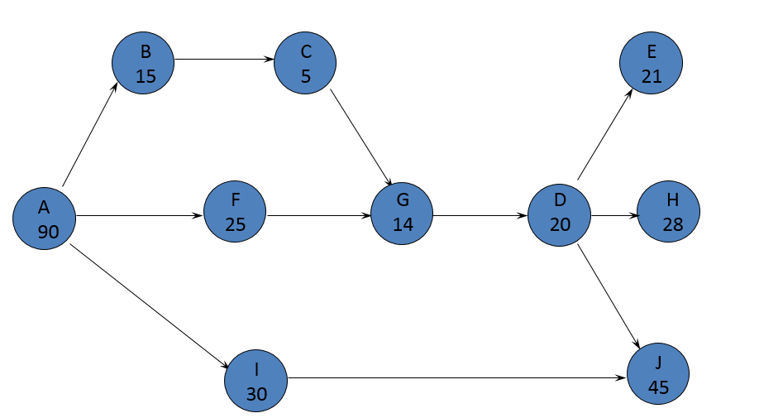
Precedence Relationships Chart

Slide 18
KLONE COMPUTERS, INC. - Continued
Management at KLONE would like to schedule the activities so that the project is completed in minimal time.
Management wishes to know:
The earliest and latest start times for each activity which will not alter the earliest completion time of the project.
The earliest finish times for each activity which will not alter this date.
Activities with rigid schedule and activities that have slack in their schedules.

Slide 19
Earliest Start Time / Earliest Finish Time
Make a forward pass through the network as follows:
Evaluate all the activities which have no immediate predecessors.
The earliest start for such an activity is zero ES = 0.
The earliest finish is the activity duration EF = Activity duration.
Evaluate the ES of all the nodes for which EF of all the immediate predecessor has been determined.
ES = Max EF of all its immediate predecessors.
EF = ES + Activity duration.
Repeat this process until all nodes have been evaluated
EF of the finish node is the earliest finish time of the project.

Slide 20
Earliest Start / Earliest Finish – Forward Pass
90,105
105,110
170
149,170
B
C
E
B
15
C
5
E
21
110,124
0,90
90,115
177
115,129
129,149
149,177
F
G
H
F
25
G
14
D
20
H
28
A
D
194
A
90
EARLIEST FINISH
120,165
194
90,120
149,194
J
I
J
45
I
30

Slide 21
Latest start time / Latest finish time
Make a backward pass through the network as follows:
Evaluate all the activities that immediately precede the finish node.
The latest finish for such an activity is LF = minimal project completion time.
The latest start for such an activity is LS = LF - activity duration.
Evaluate the LF of all the nodes for which LS of all the immediate successors has been determined.
LF = Min LS of all its immediate successors.
LS = LF - Activity duration.
Repeat this process backward until all nodes have been evaluated.

Slide 22
Latest Start / Latest Finish – Backward Pass
149,170
90,105
105,110
173,194
E
21
B
E
B
15
C
C
5
110,115
95,110
90,115
115,129
129,149
149,177
90, 115
115,129
129,149
5,95
153,173
166,194
0,90
129,149
F
129,149
146,166
F
25
D
D
20
H
G
H
28
A
0,90
G
14
129,149
A
90
129,149
194
129,149
129,149
129,149
129,149
29,119
149,194
90,120
149,194
119,149
J
I
J
45
I
30

Slide 23
Slack Times
Activity start time and completion time may be delayed by planned reasons as well as by unforeseen reasons.
Some of these delays may affect the overall completion date.
To learn about the effects of these delays, we calculate the slack time, and form the critical path.

Slide 24
Slack Times
Slack time is the amount of time an activity can be delayed without delaying the project completion date, assuming no other delays are taking place in the project.
Slack Time = LS - ES = LF - EF

Slide 25
Slack time in the Klonepalm 2000 Project
Critical activities
must be rigidly
scheduled

Slide 26
The Critical Path
The critical path is a set of activities that have no slack, connecting the START node with the FINISH node.
The critical activities (activities with 0 slack) form at least one critical path in the network.
A critical path is the longest path in the network.
The sum of the completion times for the activities on the critical path is the minimal completion time of the project.

Slide 27
The Critical Path
90,105
105,110
149,170
E
21
B
E
B
15
C
95,110
C
5
110,115
173,194
0,90
90,115
115,129
129,149
149,177
0,90
90, 115
115,129
129,149
166,194
F
F
25
D
D
20
H
G
H
28
A
G
14
A
90
149,194
90,120
149,194
119,149
J
I
J
45
I
30

Slide 28
Gantt Chart
Gantt charts illustrate the start and finish dates of the terminal elements and summary elements of a project
Gantt charts also show the dependency relationships between activities.

Slide 29
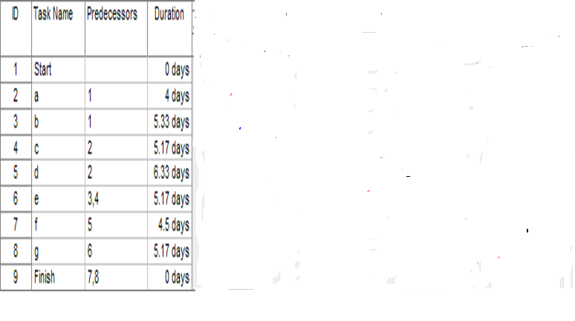
Example - 1 on Gantt Chart

Slide 30
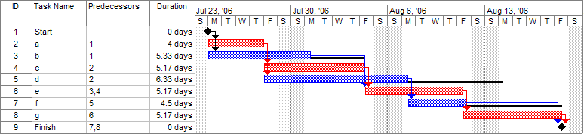
Example - 1 on Gantt Chart with Critical Path

Slide 31
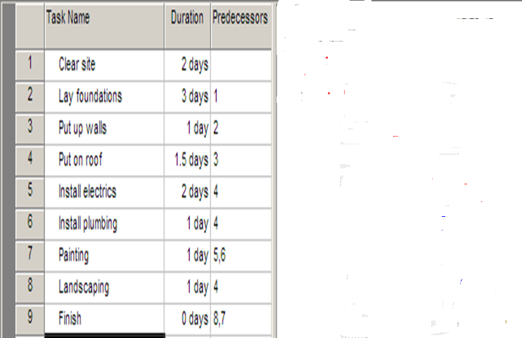
Example - 1 on Gantt Chart

Slide 32
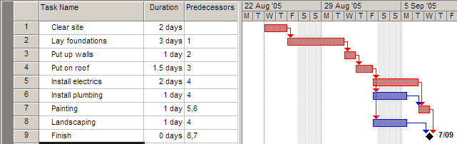
Example - 1 on Gantt Chart with Critical Path
The length of the critical path is the sum of the lengths of all critical tasks (the red tasks 1,2,3,4,5,7) which is 2+3+1+1.5+2+1 = 10.5 days.

Slide 33
PERT Chart
Program Evaluation and Review Technique (PERT)
Consists of a network of boxes (activities) and arrows (task dependencies)
Helps to identify parallel activities
PERT estimation
Optimistic
Likely
Pessimistic

Slide 34
Example on PERT estimation
.
Design DB part
40, 45, 60
(O, L, P)
Code DB part
95, 105, 120
Specification
12, 15, 20
Integrate & test
100, 120, 140
Design GUI part
20, 30, 38
Code GUI part
38, 45, 52
Finish
Write user manual
50, 60, 70

Slide 35
Gantt v/s PERT
Gantt chart is represented as a bar graph, while PERT chart is represented as a flow chart.
Gantt charts are limited to small projects and are not effective for projects with more than 30 activities.
Generally Gantt is useful for resource planning, while PERT is used for monitoring the timely progress of activities
Gantt chart do not efficiently represent the dependency of one task to another, while PERT charts can manage large projects that have numerous complex tasks a very high inter-task dependency

Slide 36
Additional Theory and Examples

Slide 37
CPM
Finding the critical path is a major part of controlling a project.
The activities on the critical path represent tasks that will delay the entire project if they are delayed.
Manager gain flexibility by identifying noncritical activities and replanning, rescheduling, and reallocating resources such as personnel and finances

Slide 38
Project Network
A project network can be constructed to model the precedence of the activities.
The arcs of the network represent the activities.
The nodes of the network represent the start and the end of the activities.
A critical path for the network is a path consisting of activities with zero slack. And it is always the longest path in the project network.

Slide 39
Drawing the project network (AOA)
An activity carries the arrow symbol, . This represent a task or subproject that uses time or resources
A node (an event), denoted by a circle , marks the start and completion of an activity, which contain a number that helps to identify its location. For example activity A can be drawn as:
A
1
2
3 days
This means activity A starts at node 1 and finishes at node 2 and it will takes three days

Slide 40
Determining the Critical Path
Step 1: Make a forward pass through the network as follows: For each activity i beginning at the Start node, compute:
Earliest Start Time (ES) = the maximum of the earliest finish times of all activities immediately preceding activity i. (This is 0 for an activity with no predecessors.). This is the earliest time an activity can begin without violation of immediate predecessor requirements.
Earliest Finish Time (EF) = (Earliest Start Time) + (Time to complete activity i. This represent the earliest time at which an activity can end.
The project completion time is the maximum of the Earliest Finish Times at the Finish node.

Slide 41
Determining the Critical Path
Step 2: Make a backwards pass through the network as follows: Move sequentially backwards from the Finish node to the Start node. At a given node, j, consider all activities ending at node j. For each of these activities, (i,j), compute:
Latest Finish Time (LF) = the minimum of the latest start times beginning at node j. (For node N, this is the project completion time.). This is the latest time an activity can end without delaying the entire project.
Latest Start Time (LS) = (Latest Finish Time) - (Time to complete activity (i,j)). This is the latest time an activity can begin without delaying the entire project.

Slide 42
Determining the Critical Path
Step 3: Calculate the slack time for each activity by:
Slack = (Latest Start) - (Earliest Start), or
= (Latest Finish) - (Earliest Finish).
A critical path is a path of activities, from the Start node to the Finish node, with 0 slack times.

Slide 43
Example: ABC Associates
Consider the following project:
Immediate
Activity Predecessor time (days)
A -- 6
B -- 4
C A 3
D A 5
E A 1
F B,C 4
G B,C 2
H E,F 6
I E,F 5
J D,H 3
K G,I 5

Slide 44
Example: network
Backward
LF
ES
6
20
Forward
6
19
D
2
5
1
5
J
6
0
A
E
H
3
6
13
23
1
C
3
4
7
0
4
F
5
13
5
B
4
I
23
K
2
3
6
G
9
18
9
18

Slide 45
Example: ABC Associates
Earliest/Latest Times
Activity time ES EF LS LF Slack
A 6 0 6 0 6 0 *critical
B 4 0 4 5 9 5
C 3 6 9 6 9 0 *
D 5 6 11 15 20 9
E 1 6 7 12 13 6
F 4 9 13 9 13 0 *
G 2 9 11 16 18 7
H 6 13 19 14 20 1
I 5 13 18 13 18 0 *
J 3 19 22 20 23 1
K 5 18 23 18 23 0 *
The estimated project completion time is the Max EF at node 7 = 23.
EF = ES + t
LS = LF – t
Where t is the
Activity time
Slack = LF – EF
= LS - ES

Slide 46
Additional Example

Slide 47
CPM – Critical Path Method
It is determined by adding the times for the activities in each sequence.
CPM determines the total calendar time required for the project.
If activities outside the critical path speed up or slow down (within limits), the total project time does not change.
The amount of time that a non-critical activity can be delayed without delaying the project is called slack-time.

Slide 48
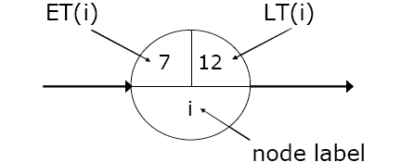
CPM – Critical Path Method
ET – Earliest node time for given activity duration and precedence relationships
LT – Latest node time assuming no delays
ES – Activity earliest start time
LS – Activity latest start time
EF – Activity earliest finishing time
LF – Activity latest finishing time
Slack Time – Maximum activity delay time

Slide 49
CPM – Critical Path Method
Step 1. Calculate ET for each node.
For each node i for which predecessors j are labelled with ET(j), ET(i) is given
by:
ET(i)= maxj [ET(j)+ t(j,i)]
where t(j,i) is the duration of task between nodes (j,i).
Step 2. Calculate LT for each node.
For each node i for which successors j are labelled with LT(j), LT(i) is given by:
LT(i)= minj [LT(j) – t(i,j)]
where t(j,i) is the duration of task between nodes (i,j).

Slide 50
CPM – Critical Path Method
A ( 3 )
2
D ( 5 )
1
5
B ( 4 )
E ( 2 )
C ( 7 )
3
4

Slide 51
CPM – Critical Path Method
A ( 3 )
2
D ( 5 )
0
1
5
B ( 4 )
E ( 2 )
C ( 7 )
3
4

Slide 52
CPM – Critical Path Method
3
A ( 3 )
2
D ( 5 )
0
1
5
B ( 4 )
E ( 2 )
4
C ( 7 )
3
4

Slide 53
CPM – Critical Path Method
3
A ( 3 )
2
D ( 5 )
0
1
5
B ( 4 )
E ( 2 )
4
C ( 7 )
11
3
4

Slide 54
CPM – Critical Path Method
3
13
A ( 3 )
2
D ( 5 )
0
1
5
B ( 4 )
E ( 2 )
4
C ( 7 )
11
3
4
54
Software Project Management
Maria Petridou
Notes:
54
10/28/2020
Maria Petridou
University of Nottingham

Slide 55
CPM – Critical Path Method
3
13
A ( 3 )
2
D ( 5 )
8
0
1
5
B ( 4 )
E ( 2 )
4
C ( 7 )
11
3
4
55
Software Project Management
Maria Petridou
Notes:
55
10/28/2020
Maria Petridou
University of Nottingham

Slide 56
CPM – Critical Path Method
3
13
A ( 3 )
8
max
2
D ( 5 )
0
1
5
B ( 4 )
E ( 2 )
4
C ( 7 )
11
3
4
56
Software Project Management
Maria Petridou
Notes:
56
10/28/2020
Maria Petridou
University of Nottingham

Slide 57
CPM – Critical Path Method
3
A ( 3 )
2
D ( 5 )
0
13
1
5
B ( 4 )
E ( 2 )
4
C ( 7 )
11
3
4

Slide 58
CPM – Critical Path Method
3
A ( 3 )
2
D ( 5 )
0
13
13
1
5
B ( 4 )
E ( 2 )
4
C ( 7 )
11
3
4

Slide 59
CPM – Critical Path Method
3
A ( 3 )
2
D ( 5 )
0
13
13
1
5
B ( 4 )
E ( 2 )
4
C ( 7 )
11
11
3
4

Slide 60
CPM – Critical Path Method
3
8
A ( 3 )
2
D ( 5 )
0
13
13
1
5
B ( 4 )
E ( 2 )
4
C ( 7 )
11
11
3
4

Slide 61
CPM – Critical Path Method
3
8
A ( 3 )
2
D ( 5 )
0
13
13
1
5
B ( 4 )
E ( 2 )
4
4
C ( 7 )
11
11
3
4

Slide 62
CPM – Critical Path Method
5
3
8
A ( 3 )
2
D ( 5 )
0
13
13
1
5
B ( 4 )
E ( 2 )
4
4
C ( 7 )
11
11
3
4
62
Software Project Management
Maria Petridou
Notes:
62
10/28/2020
Maria Petridou
University of Nottingham

Slide 63
CPM – Critical Path Method
5
3
8
0
A ( 3 )
2
D ( 5 )
0
13
13
1
5
B ( 4 )
E ( 2 )
4
4
C ( 7 )
11
11
3
4
63
Software Project Management
Maria Petridou
Notes:
63
10/28/2020
Maria Petridou
University of Nottingham

Slide 64
CPM – Critical Path Method
5
3
8
min
0
A ( 3 )
2
D ( 5 )
0
13
13
1
5
B ( 4 )
E ( 2 )
4
4
C ( 7 )
11
11
3
4
64
Software Project Management
Maria Petridou
Notes:
64
10/28/2020
Maria Petridou
University of Nottingham

Slide 65
CPM – Critical Path Method
3
8
A ( 3 )
2
D ( 5 )
0
0
13
13
1
5
B ( 4 )
E ( 2 )
4
4
C ( 7 )
11
11
3
4

Slide 66
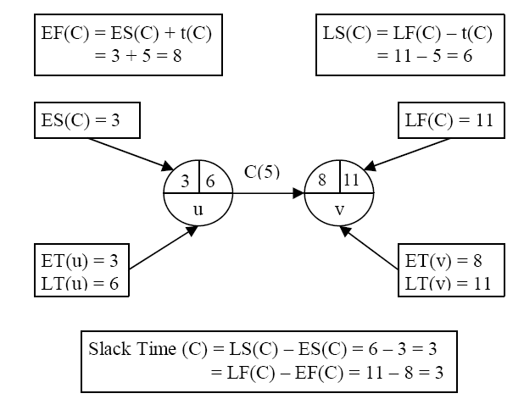
CPM – Critical Path Method
An activity with zero slack time is a critical activity and cannot be delayed without causing a delay in the whole project.

Slide 67
CPM – Critical Path Method
Step 3. Calculate processing times for each activity.
For each activity X with start node i and end node j:
ES(X) = ET(i)
EF(X) = ES(X) + t(X)
LF(X) = LT(j)
LS(X) = LF(X) – t(X)
Slack Time (X) = LS(X) – ES(X) = LF(X) – EF(X)
Where t(X) is the duration of activity X.
An activity with zero slack time is a critical activity and cannot be delayed without causing a delay in the whole project.

Slide 68
CPM – Critical Path Method
Step 3. Calculate processing times for each activity.
Task | Duration | ES | EF | LS | LF | Slack | Critical Task
A | 3 | 0 | 3 | 5 | 8 | 5 | No
B | 4 | 0 | 4 | 0 | 4 | 0 | Yes
C | 7 | 4 | 11 | 4 | 11 | 0 | Yes
D | 5 | 3 | 8 | 8 | 13 | 5 | No
E | 2 | 11 | 13 | 11 | 13 | 0 | Yes
Reading: (Kendall&Kendall, chapter 3), (Dennis &Wixom, chapter 3)

Slide 69
CPM – Critical Path Method
3
8
A ( 3 )
2
D ( 5 )
0
0
13
13
1
5
B ( 4 )
E ( 2 )
4
4
C ( 7 )
11
11
3
4

